Slide 1


Welcome to the
Nextcloud community :) nextcloud.com
Efstathios Iosifidis @eiosifidis

Slide 2
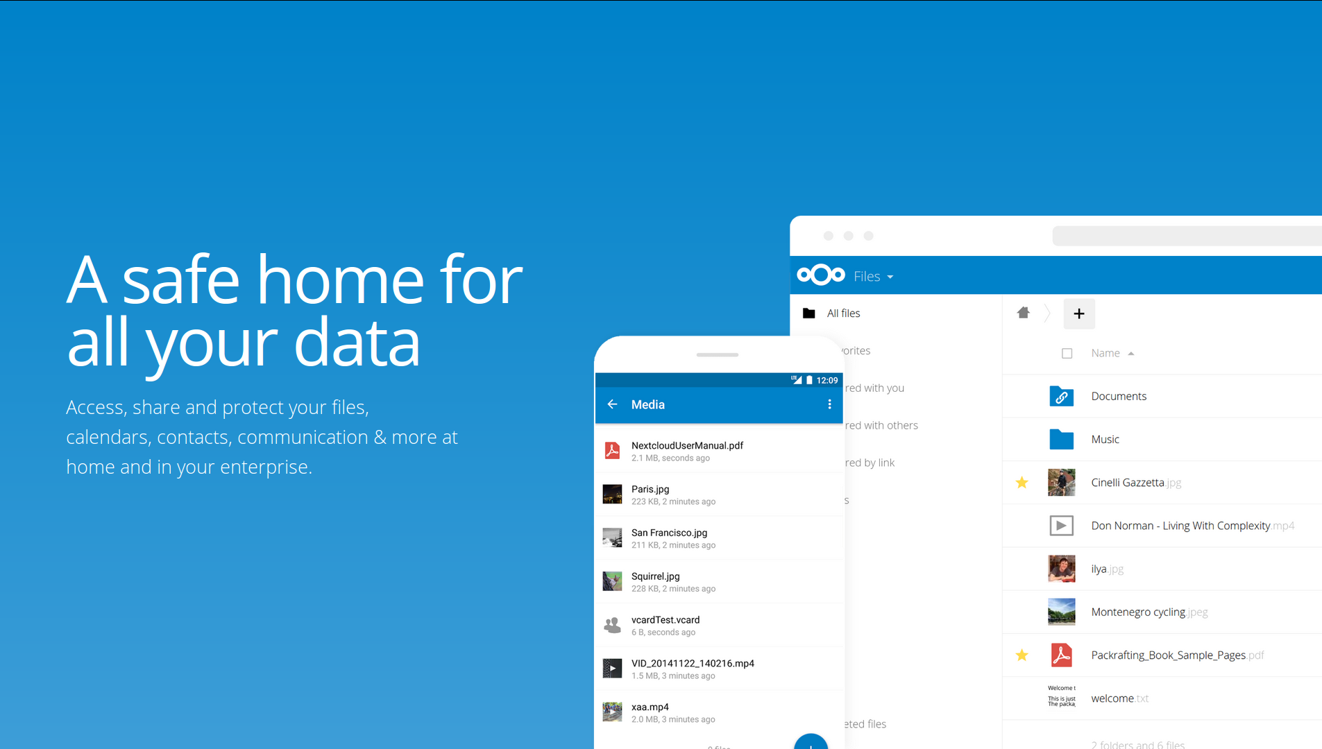

Slide 3
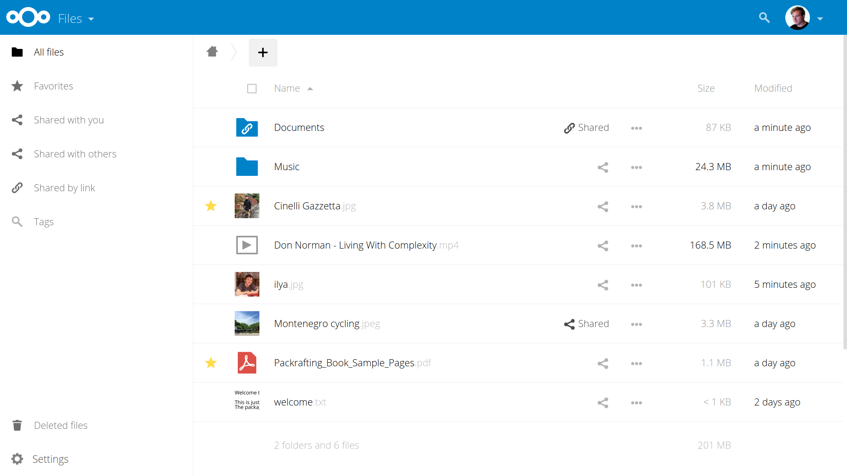

Slide 4
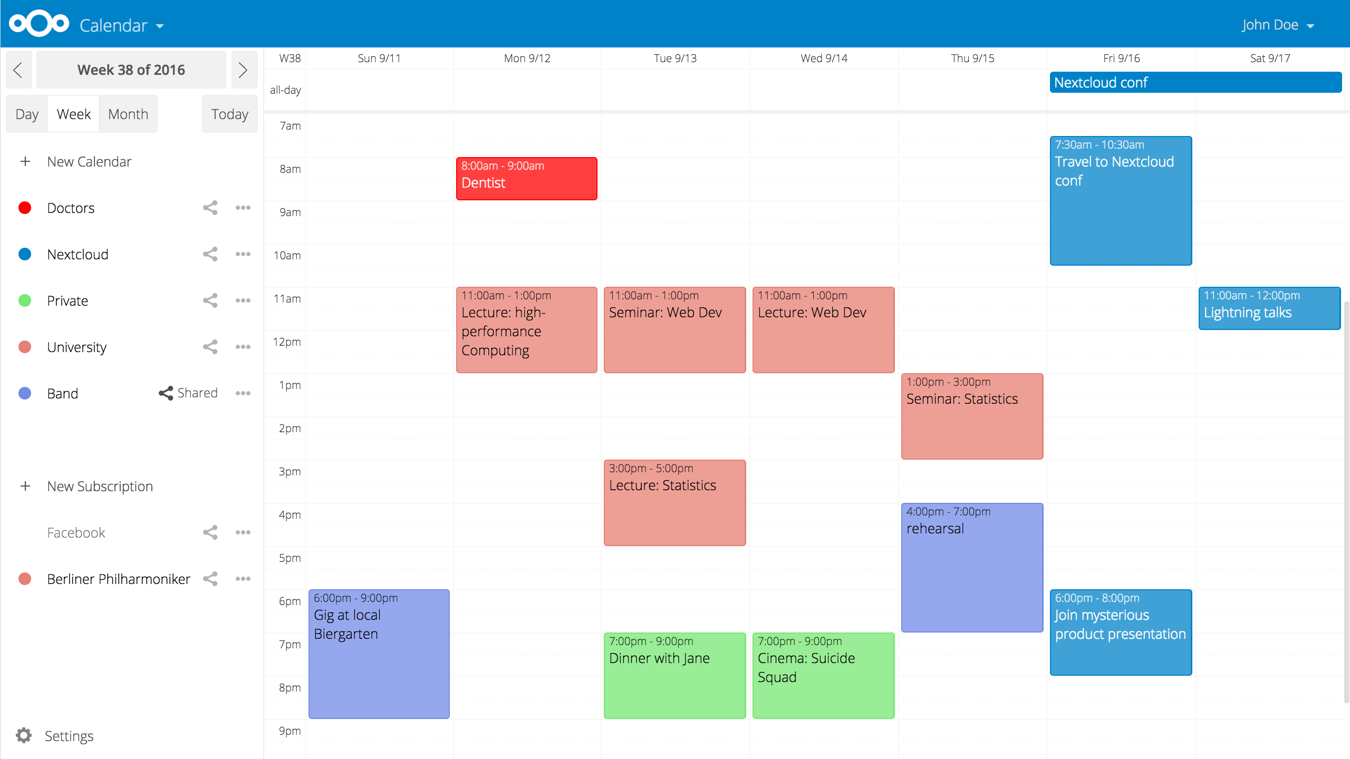

Slide 5
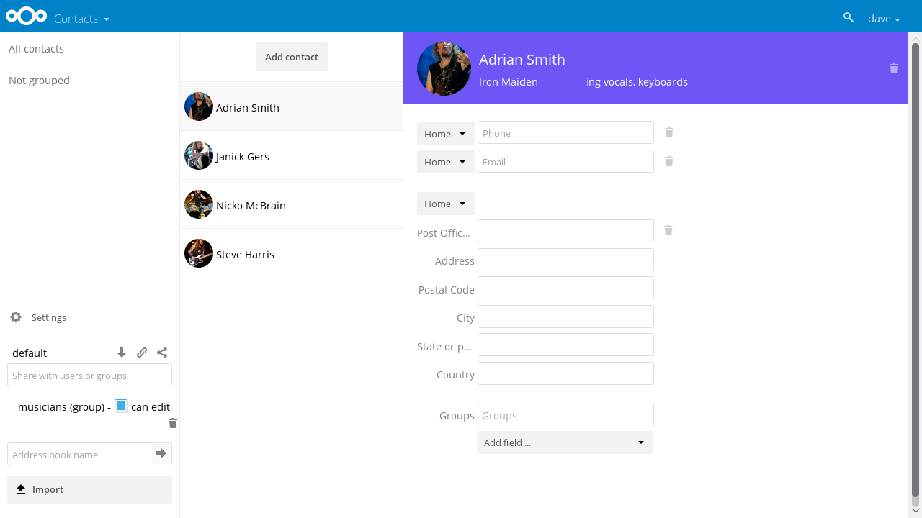

Slide 6
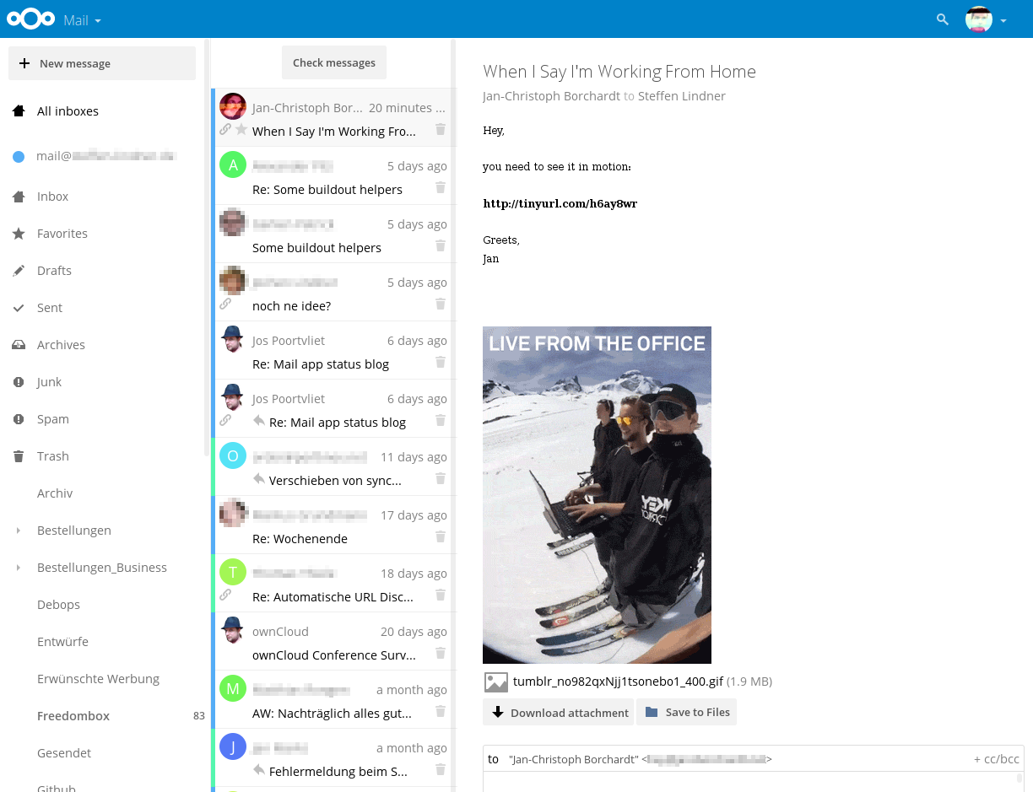

Slide 7
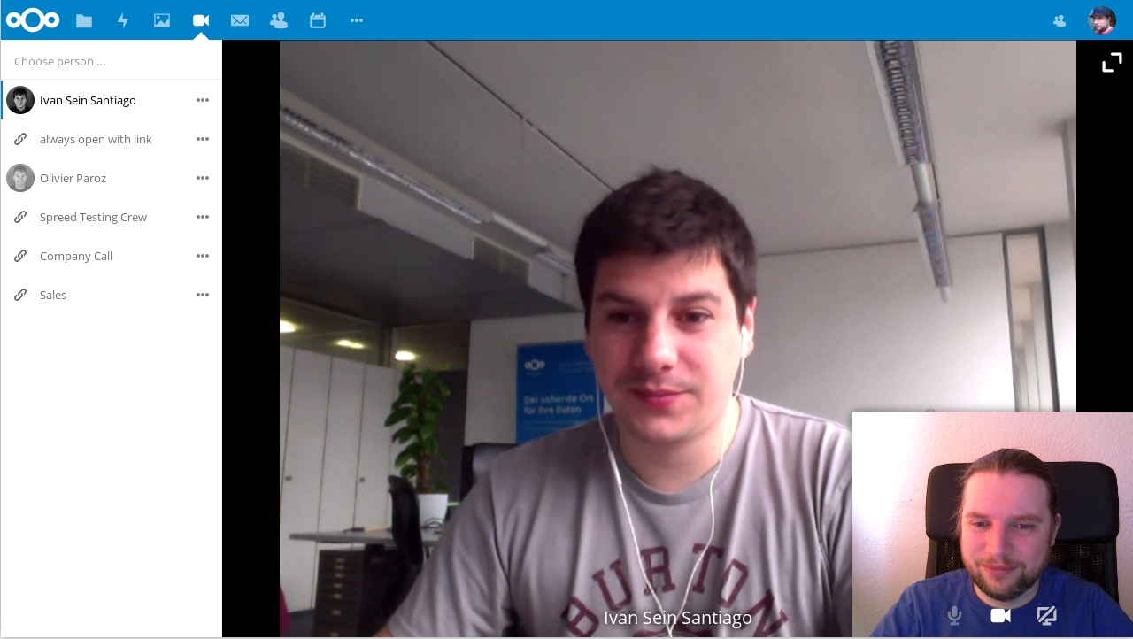

Slide 8
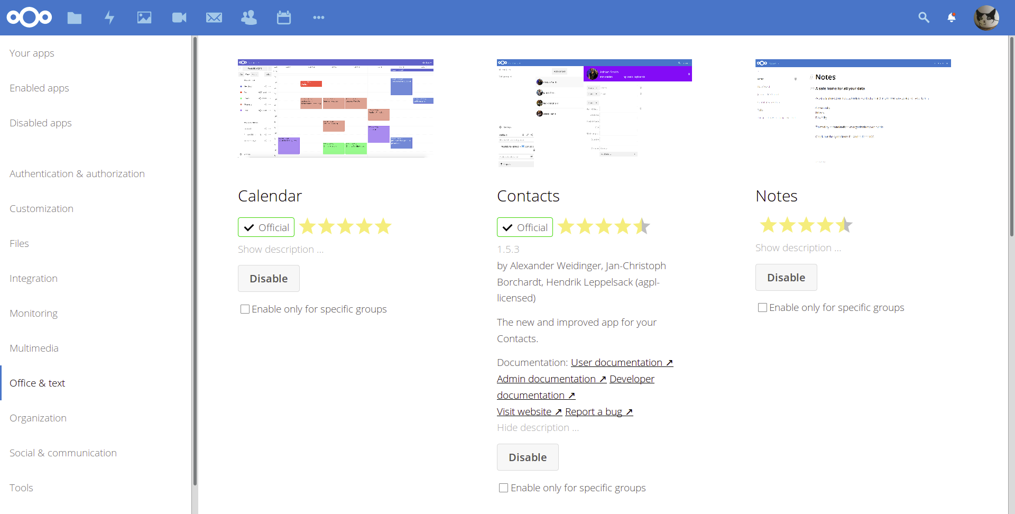

Slide 9
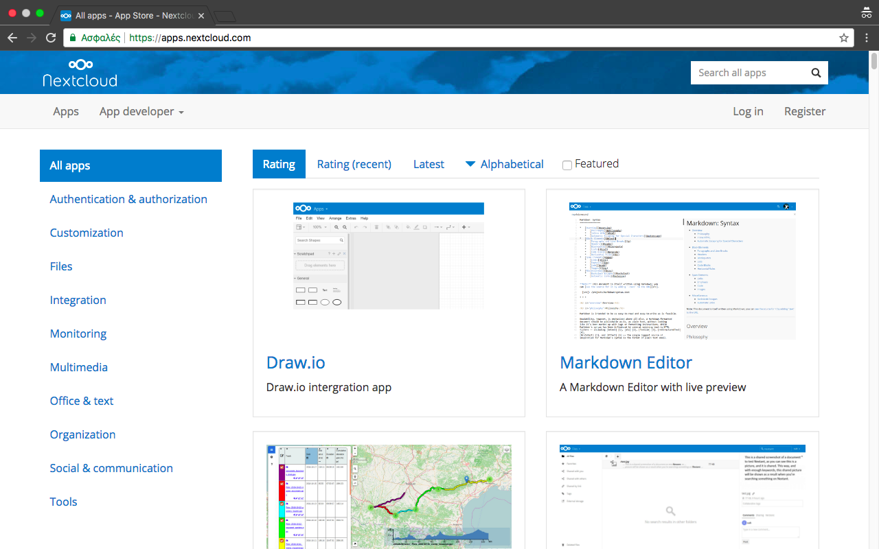

Slide 10
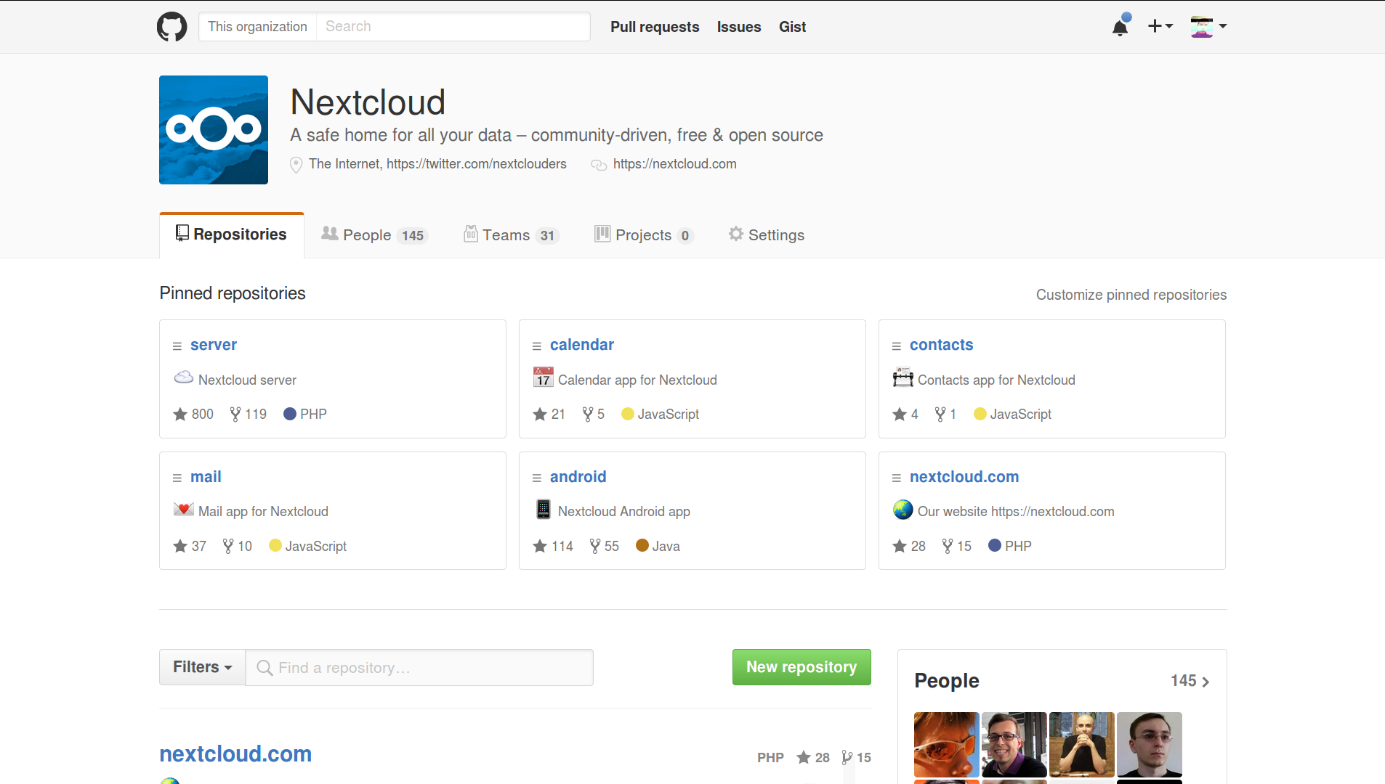

Slide 11
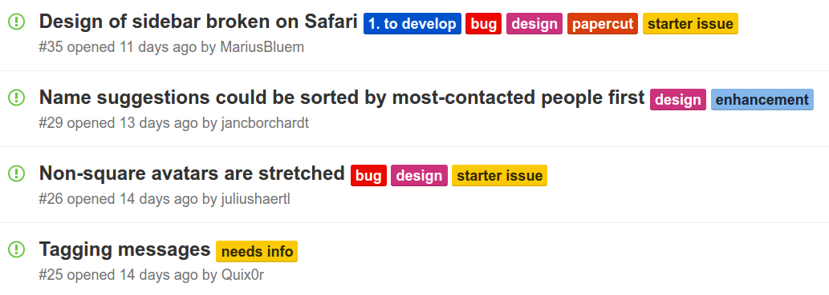
starter issue

Slide 12
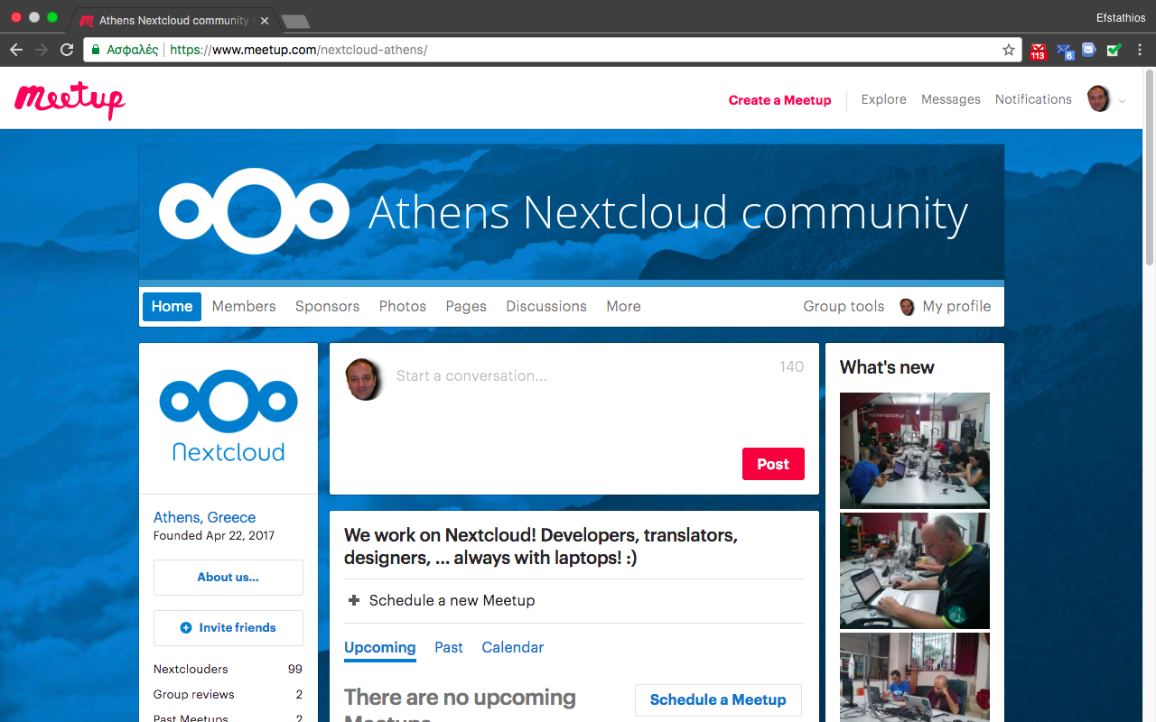

Slide 13
See you on github.com/nextcloud
:)

Slide 14
Sync outside the box
Nextcloud guiding principles
Efstathios Iosifidis @eiosifidis

Slide 15

Quick backstory …

Slide 16



May & June 2016
forked

Slide 17
nextcloud.com
/migration

Slide 18
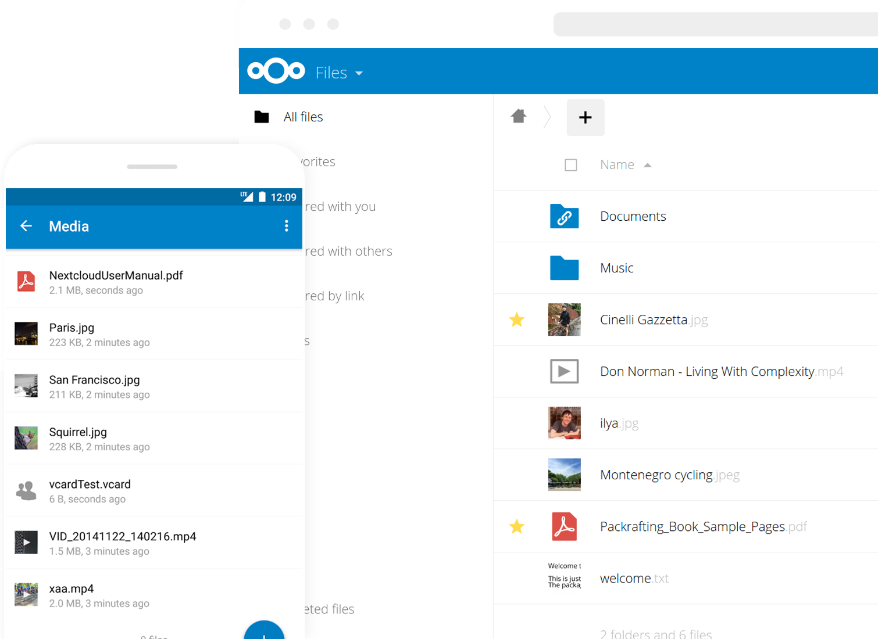
Nextcloud

Slide 19
Project & community
– not just a product

Slide 20
6
Guiding principles
& values

Slide 21
1
Financial sustainability

Slide 22
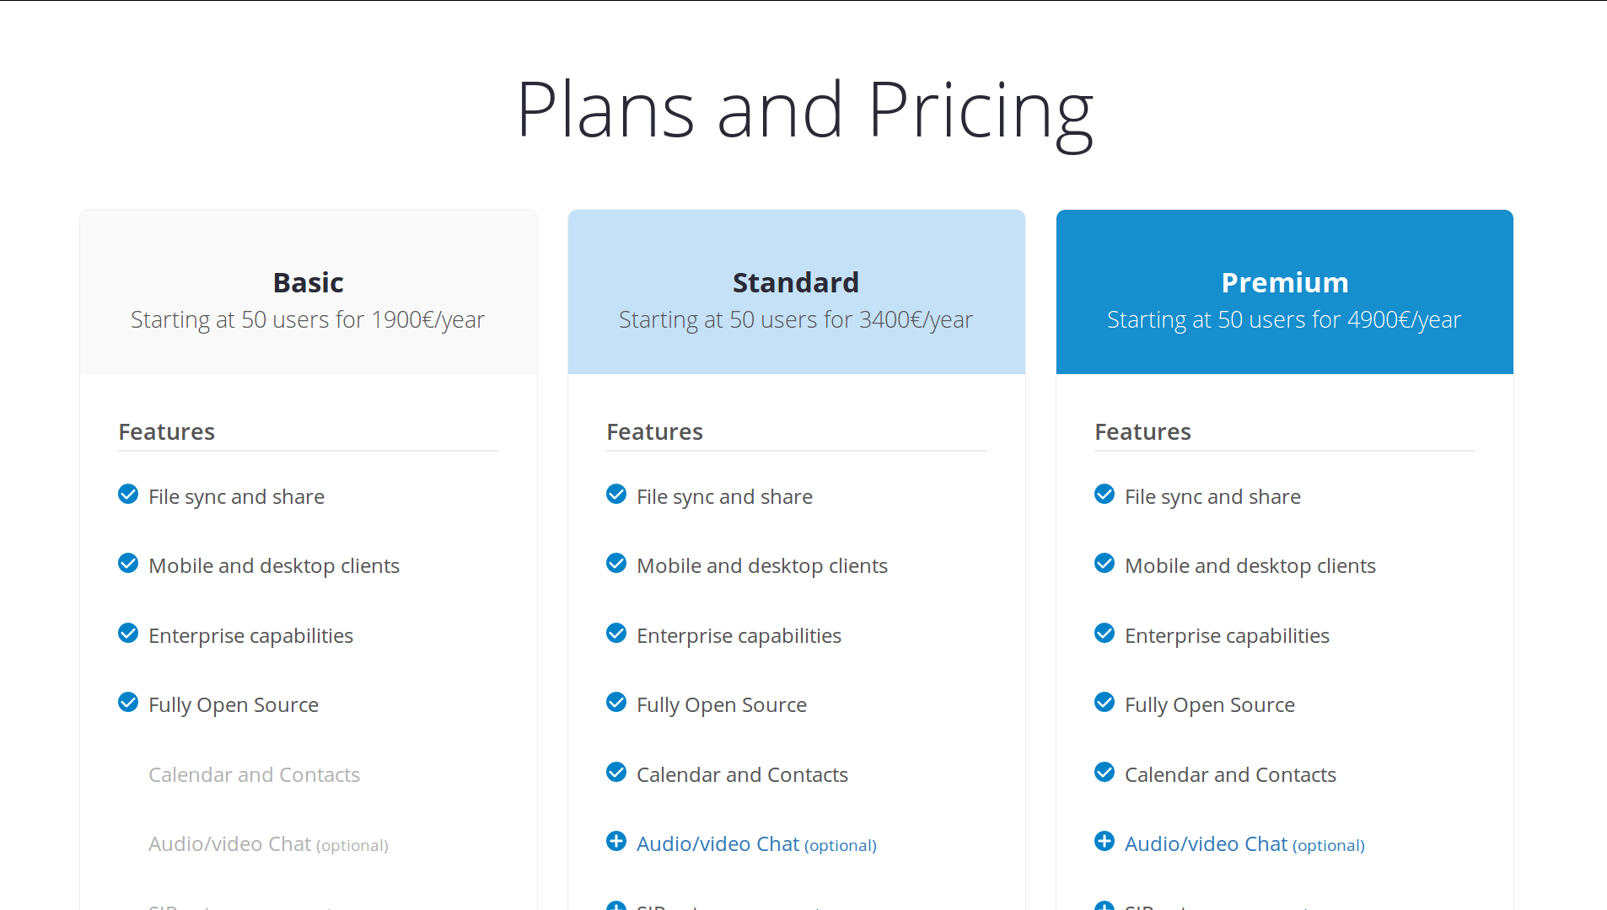
No closed source parts No venture capital

Slide 23
2
Free & open source software

Slide 24
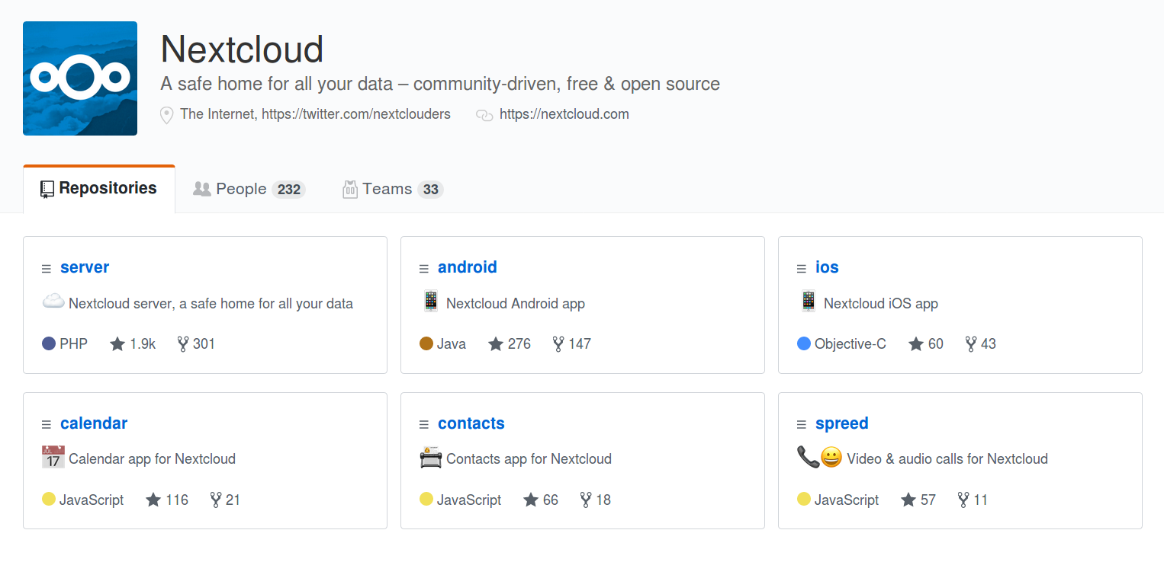
All AGPL No Contributor License Agreement

Slide 25
3
Open standards

Slide 26




WebDAV CalDAV CardDAV
WebRTC XMPP RSS IMAP

Slide 27
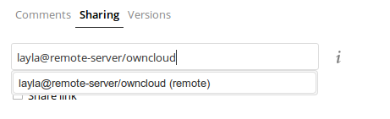


Federation

Slide 28
4
Collaboration with other projects

Slide 29
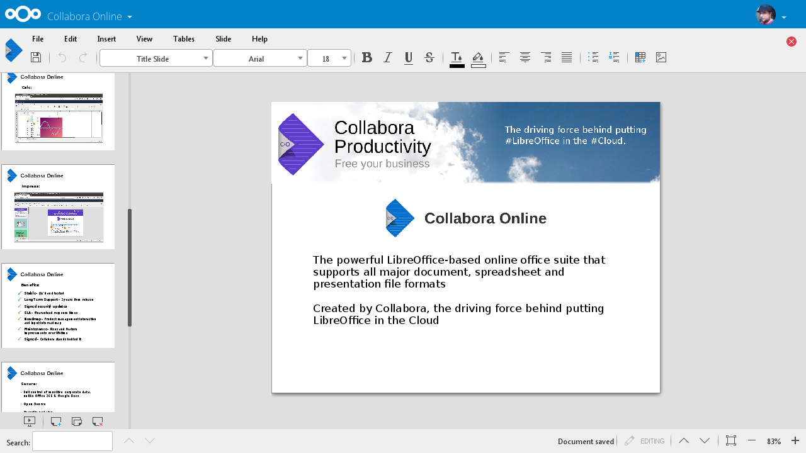

Slide 30
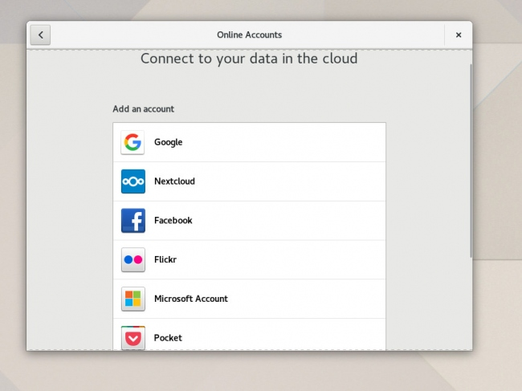

Slide 31
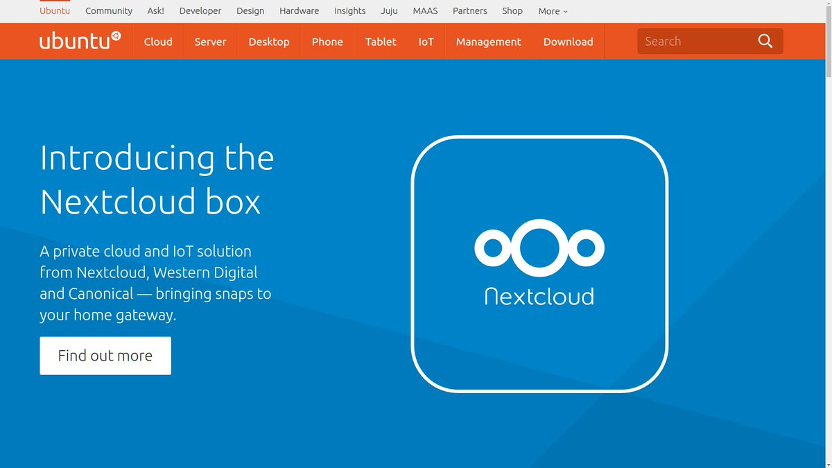

Slide 32
5
Community online & offline

Slide 33
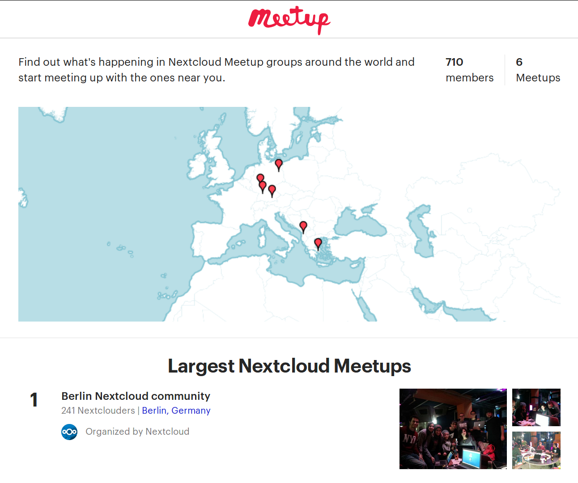

Slide 34
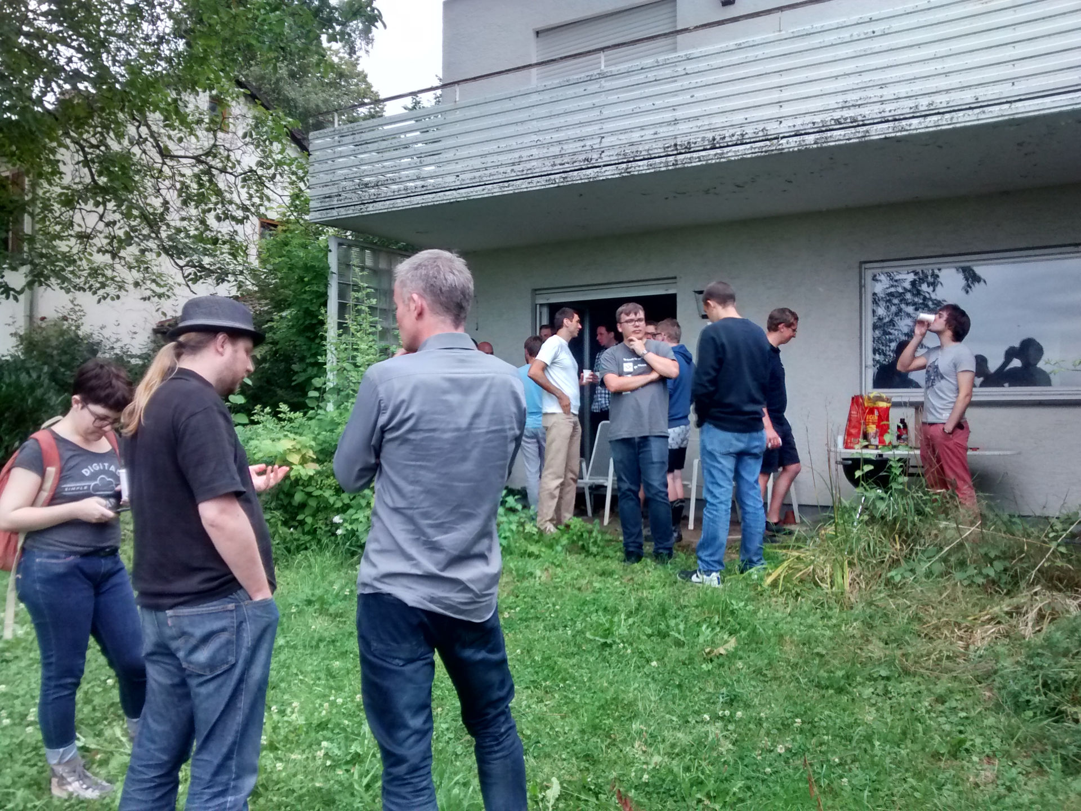

Slide 35
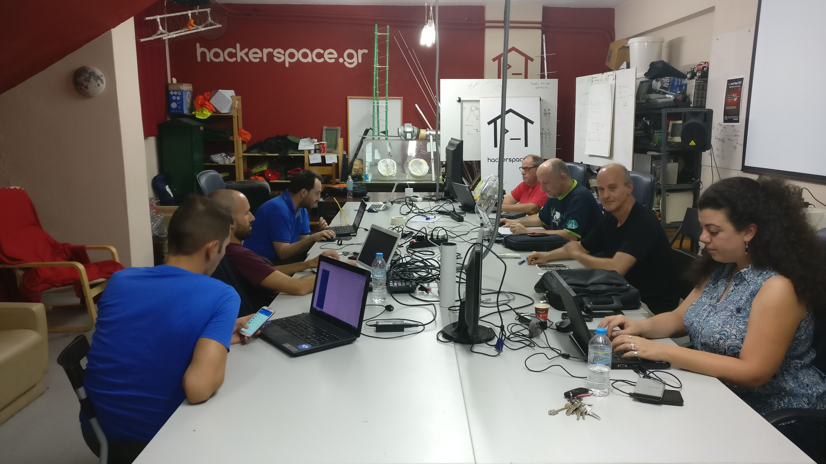

Slide 36
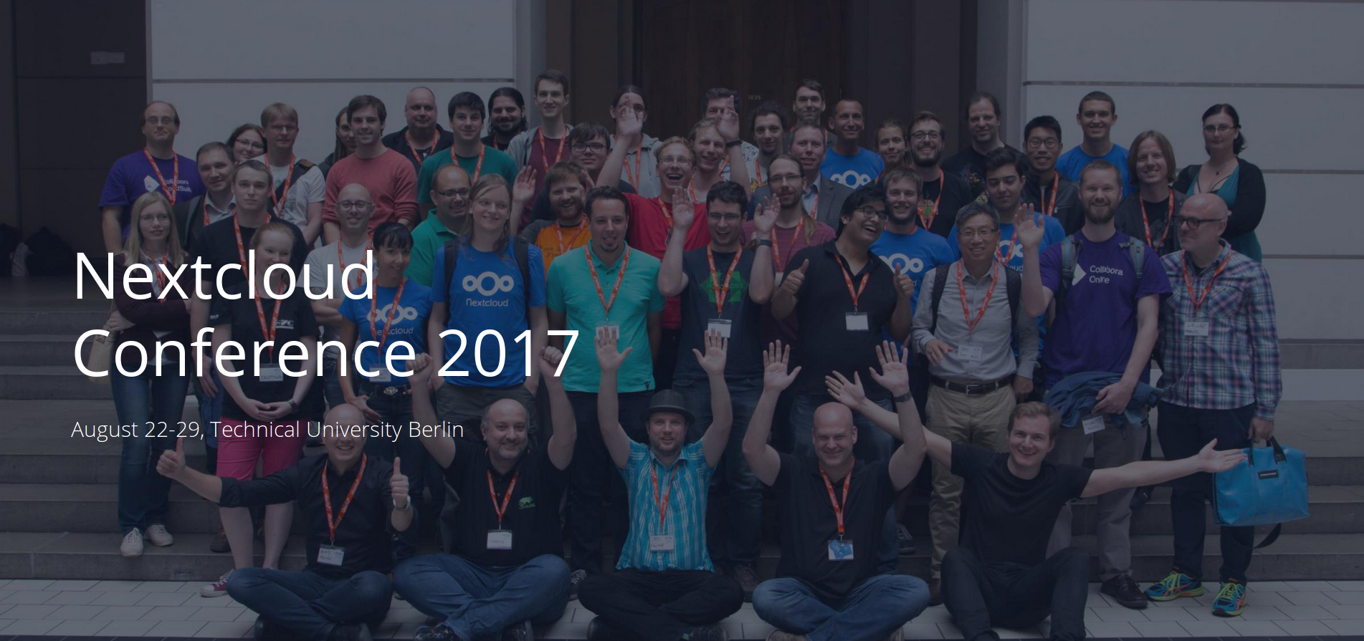

Slide 37
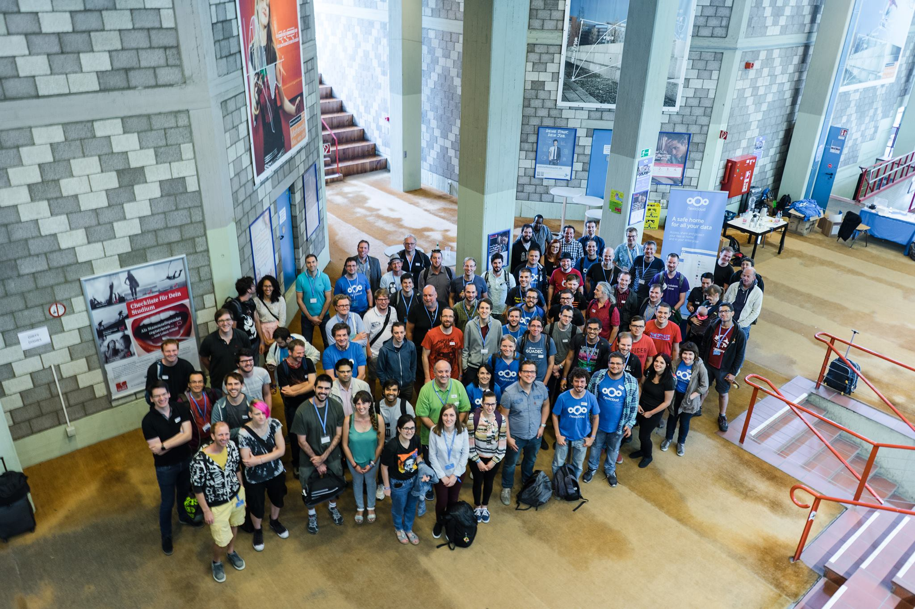

Slide 38
6
Diversity
& inclusion

Slide 39




Slide 40
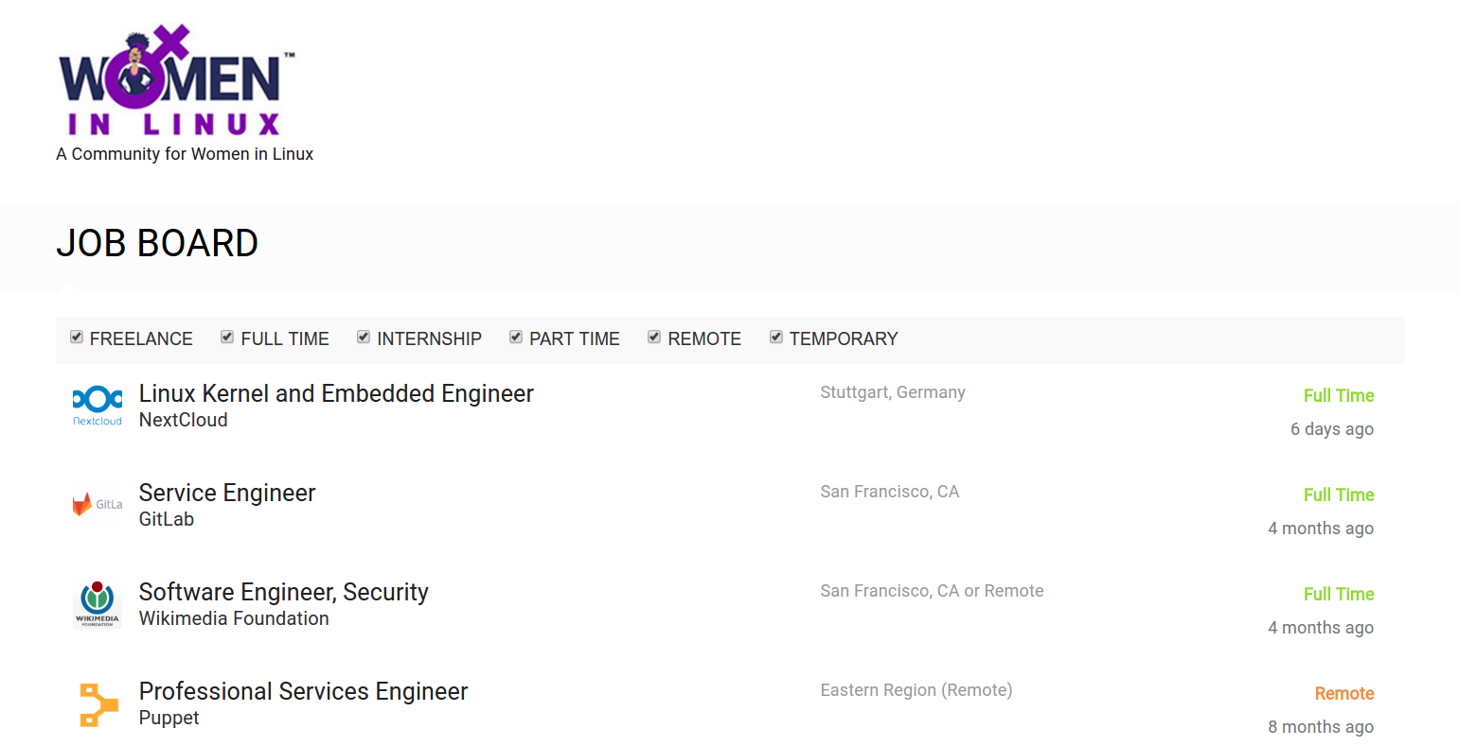

Slide 41
starter issue
yourfirstpr.github.io up-for-grabs.net

Slide 42
nextcloud.com/contribute www.fb.com/groups/nextcloudgr www.meetup.com/nextcloud-athens/ t.me/nextcloudgr
Thank you ❤
Efstathios Iosifidis @eiosifidis

